Slide 1
Load Flexibility Measure:
Central Ice Storage
Preliminary Measure Discussion
September 20, 2019

Slide 2
Objectives of the Measure
Implement rapid and accurate modeling solution for evaluation of ice storage using building energy models
Permits parametric analysis of design and control options
Implements ASHRAE Design Guide for Cool Thermal Storage configuration options and recommended controls

Slide 3
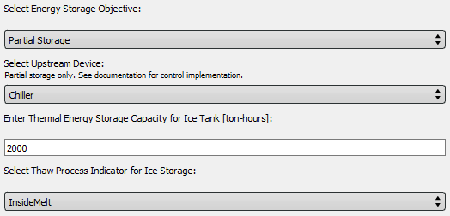
User Inputs
Partial Storage
Full Storage
Chiller Upstream
Storage Upstream
Inside Melt
Outside Melt

Slide 4
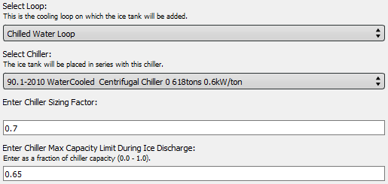
User Inputs
Chiller Downsizing
Chiller De-Rate
During Ice Discharge

Slide 5
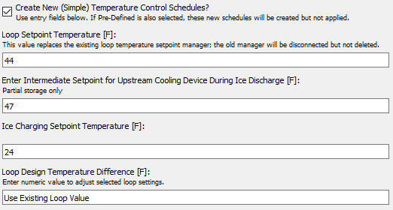
User Inputs
Setpoint Between Chiller and Ice Tank

Slide 6
Multiple Ways to Achieve Controls
Documentation provides “recipes” translating Design Guide terms into measure inputs
Full Storage
Partial Storage
Load Leveling
Demand Limiting
Ice Priority
Chiller Priority

Slide 7
Discussion

Slide 8
Thank you!

Slide 9
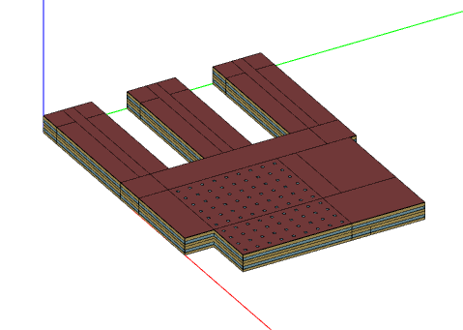
Model 2: Partial Storage Secondary School
Secondary School (2010):
Climate zone 2A
Houston, TX weather (TMY3)
210,000 ft² conditioned space
Air-cooled screw chiller (downsized)
2000 ton-hours of ice storage
Chiller-upstream, storage-priority 0800-2000 on weekdays

Slide 10
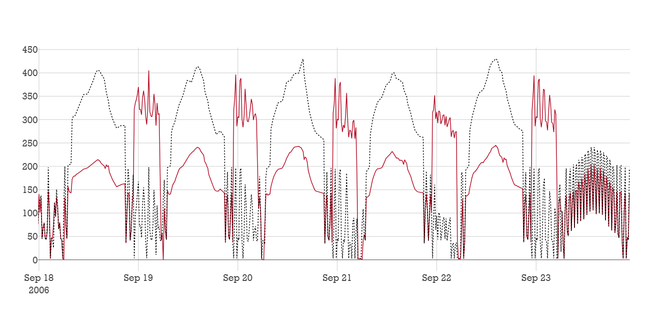
Secondary School: Chiller Electric Power
Baseline CTES
kWe

Slide 11
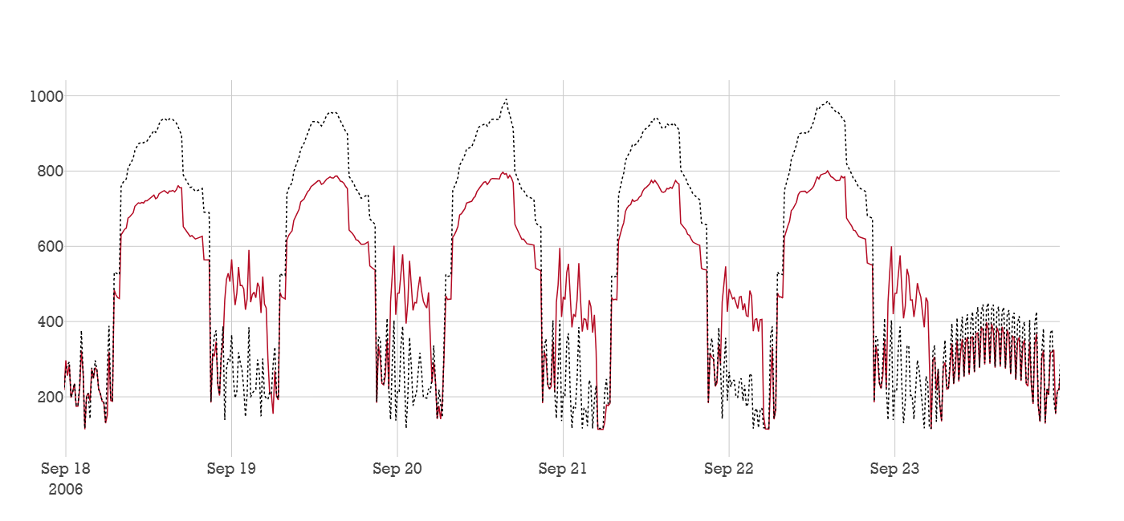
Secondary School: Facility Electric Power
Baseline CTES
kWe

Slide 12
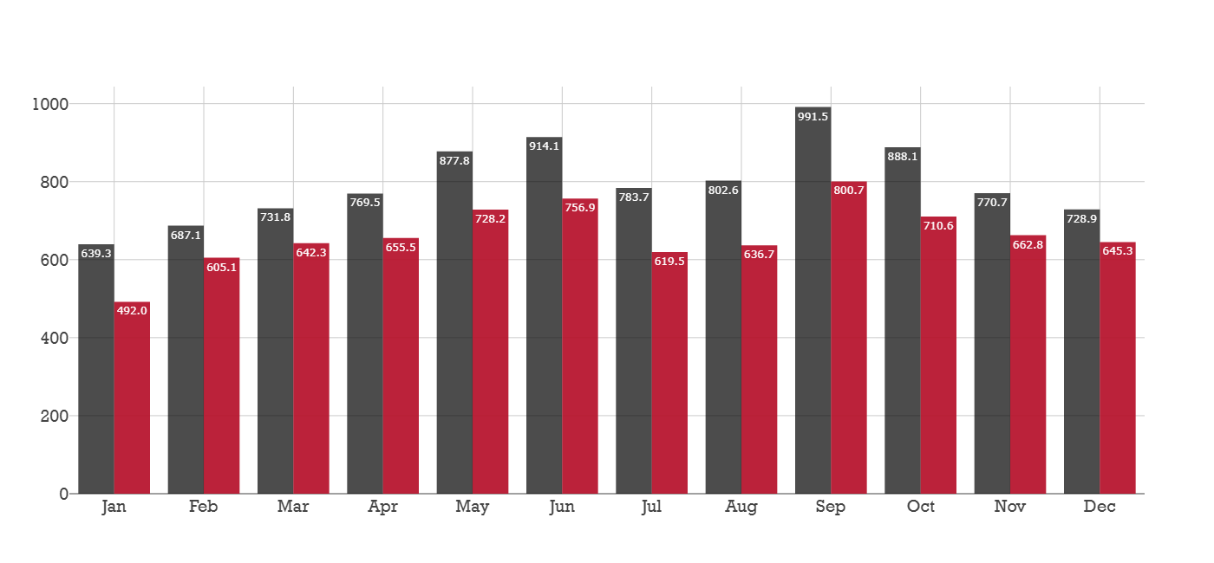
Secondary School: Monthly Peak Demand
Baseline CTES
kWe

Slide 13
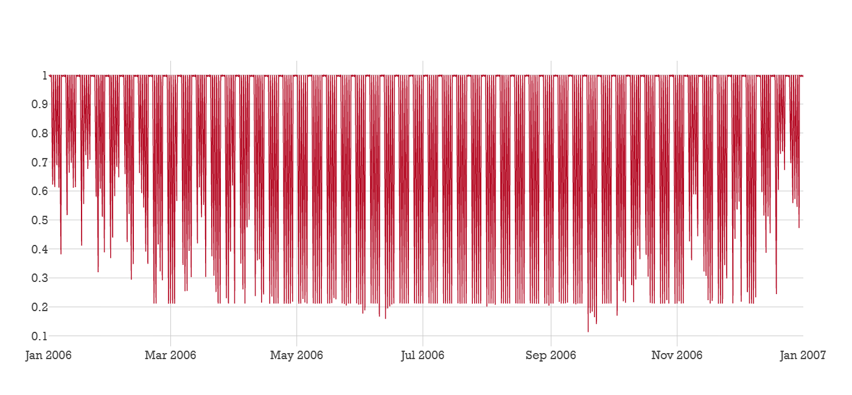
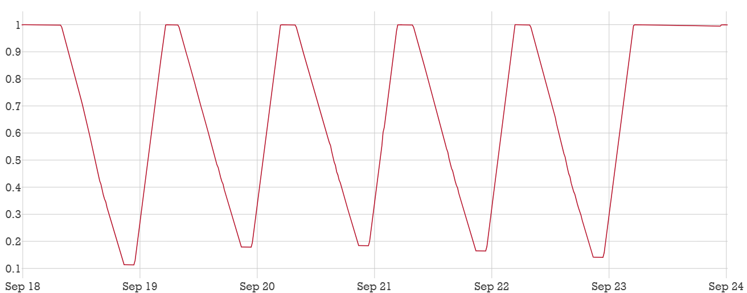
Secondary School: Ice Use
State of Charge

Slide 14
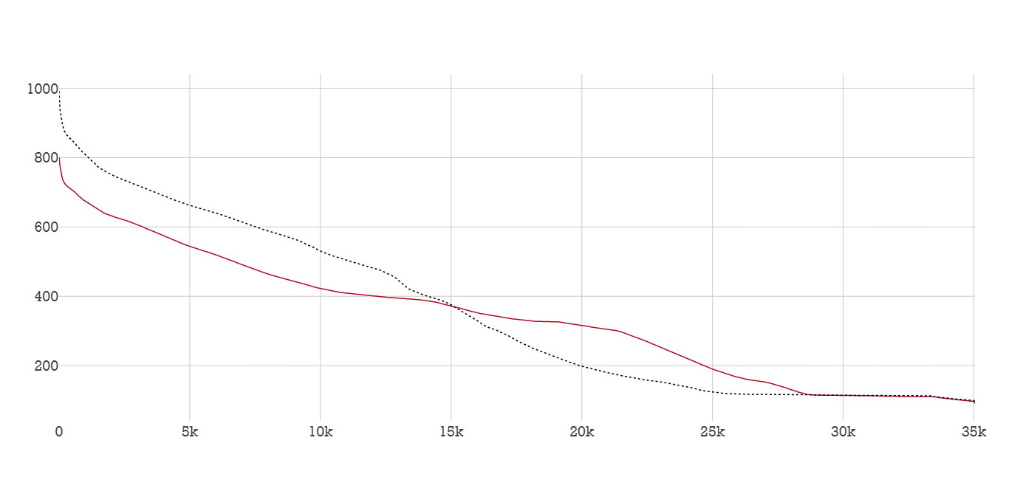
Secondary School: Facility Load Duration
Baseline CTES
kWe

Slide 15
Results Summary
Model | EUI [kWh/m²] | Facility Annual Electricity [MWh] | Chiller Annual Electricity [MWh]
School Baseline | 157.7 | 3,091 | 973
School Partial Storage | 150.5 (-4%) | 2,948 (-4%) | 845 (-23%)

Slide 16
Results Summary
Model | Min Ice SoC | Chiller Size [tons] | Average Chiller COP | Runtime Hours
School Baseline | - | 578 | 2.55 | 5947
School Partial Storage | 11% | 405 (-30%) | 3.07 (+20%) | 5768 (-3%)

Slide 17
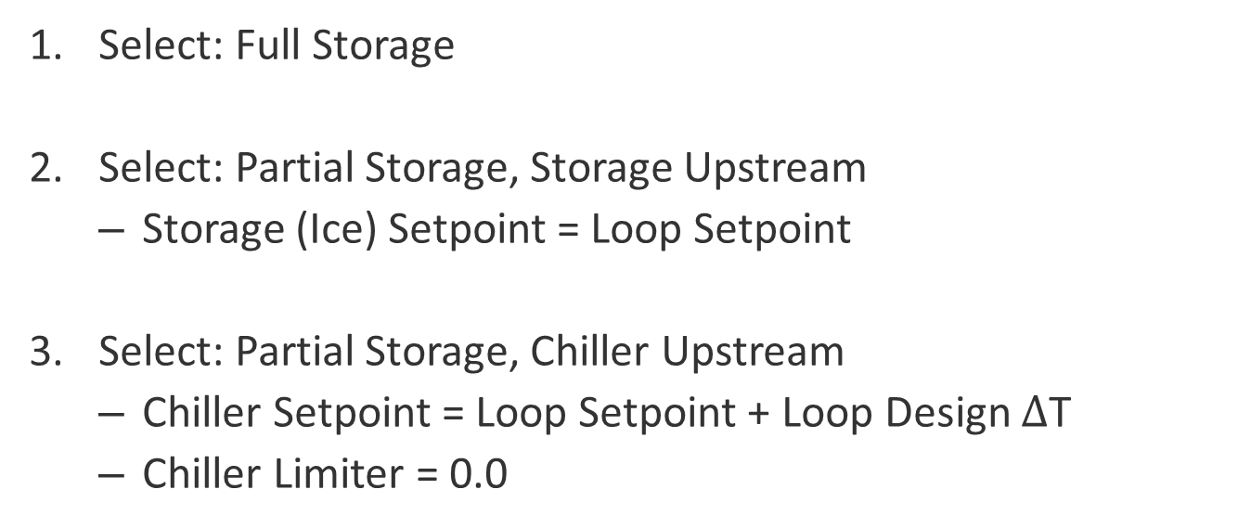
Full Storage
Select: Full Storage
Select: Partial Storage, Storage Upstream
Storage (Ice) Setpoint = Loop Setpoint
Select: Partial Storage, Chiller Upstream
Chiller Setpoint = Loop Setpoint + Loop Design $Δ$T
Chiller Limiter = 0.0

Slide 18
Partial Storage: Load Leveling
Select: Chiller Upstream, Downsize Chiller
Chiller Setpoint = Loop Setpoint
Requires Iteration to “Level” the Load

Slide 19
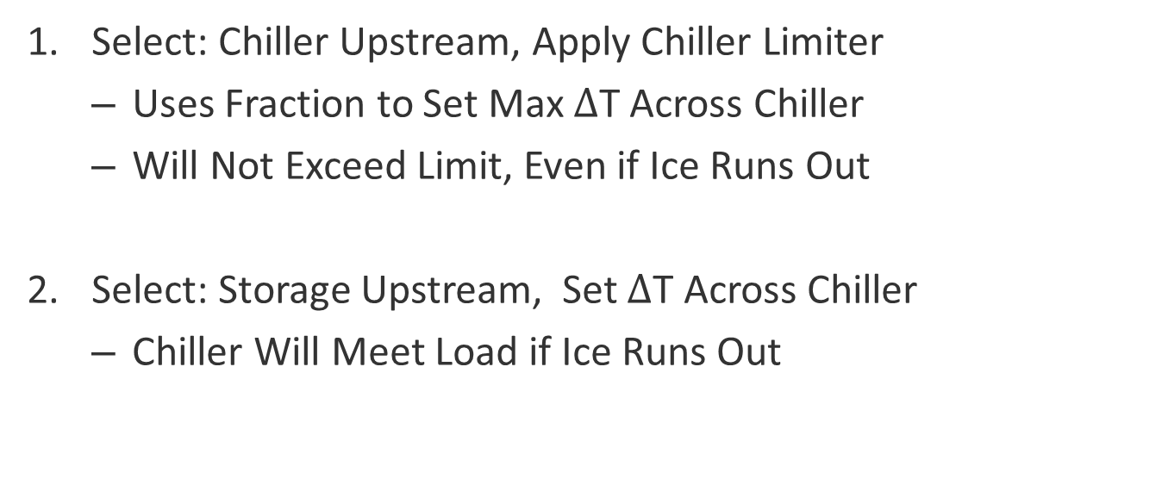
Partial Storage: Demand Limiting
Select: Chiller Upstream, Apply Chiller Limiter
Uses Fraction to Set Max $Δ$T Across Chiller
Will Not Exceed Limit, Even if Ice Runs Out
Select: Storage Upstream, Set $Δ$T Across Chiller
Chiller Will Meet Load if Ice Runs Out

Slide 20
Discharge Priorities
Configuration Matters:
Chiller Priority –> Select Storage Upstream
Chiller Meets Load First, Up to a Maximum Value
Chiller Load More Uniform
Storage Priority –> Select Chiller Upstream
Ice Meets Load First, Up to a Maximum Value
Ice Usage More Uniform

Slide 21
Baseloading with Multiple Chillers
Select: Single Chiller on Multiple-Chiller Loop
Modifies Loop Setpoint Manager
Modifies Selected Branch Components
Limited Testing to Date

Slide 22
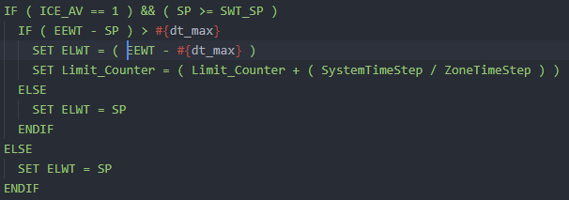
EMS Script: Chiller Limiter
ICE_AV: Ice Availability (On/Off)
SP: Chiller Setpoint Temperature
SWT_SP: Supply Water Setpoint Temperature
EEWT: Evaporator Entering Water Temperature
dt_max: Max Temperature Difference on Chiller
ELWT: Evaporator Leaving Water Temperature Setpoint Actuator
Limit_Counter: Instances of Limiter Use

